Slide 1
Application of Deep Learning on Image Deblurring
Mattia Orlandi & Giacomo Pinardi

Slide 2
Contents
Datasets
Convolutional Autoencoders (CAEs)
Models
Experimental results
Wasserstein Generative Adversarial Networks (WGANs):
Models
Experimental results
Tools
REDNet30 on GOPRO

Slide 3
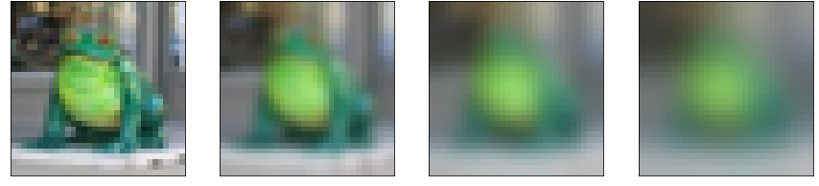
Datasets - CIFAR10
Constructed by applying Gaussian blur with random standard deviation between 0 and 3
Basic data augmentation: horizontal and/or vertical flip

Slide 4
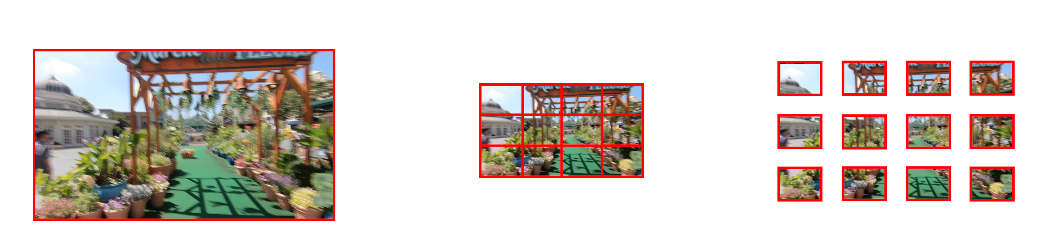
Datasets - REDS
Resolution reduction from 1280x720 to 512x288
Patch-based approach: each image is splitted into 12 patches analysed separately
Basic data augmentation: horizontal and/or vertical flip

Slide 5
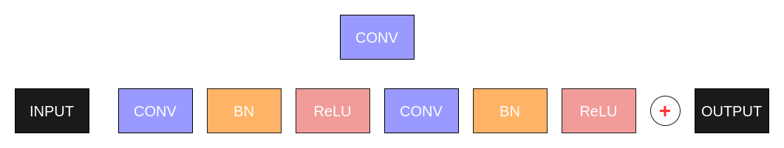
Convolutional Autoencoders - ResNet16
It comprises an encoder and a decoder, each made of 4 residual blocks:
the encoder shrinks the input image using standard strided convolutions
the decoder enlarges the latent image using transposed strided convolutions
Residual connections inspired by ResNet50 (for image classification)

Slide 6
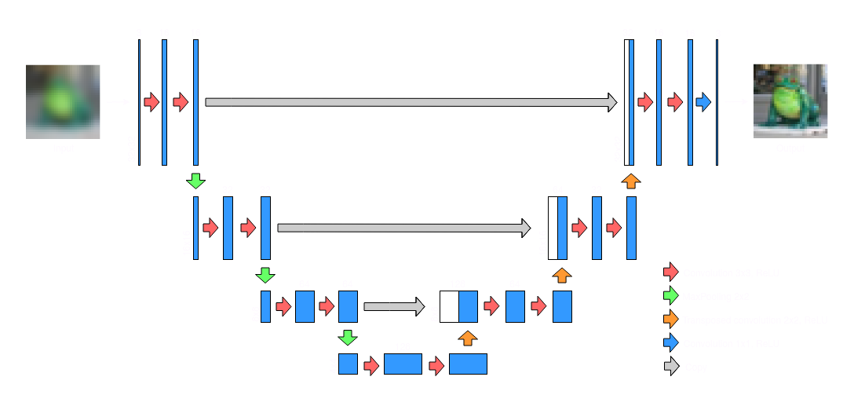
Convolutional Autoencoders - UNet16
Based on UNet model for image segmentation:
contracting path (convolutional layers + max pooling)
expansive path (common + transposed convolutions)

Slide 7
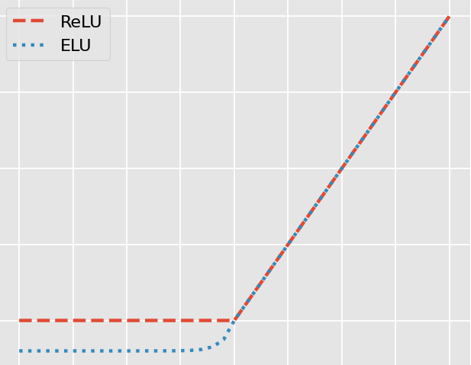
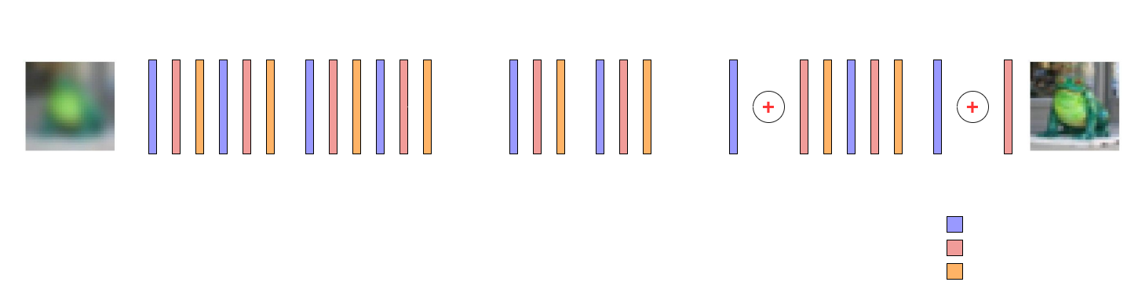
Convolutional Autoencoders - REDNet30
30 blocks made of:
Convolution 3x3 with stride 1 and padding
Exponential Linear Unit
Batch Normalization
Symmetrical residual connections every 2 blocks
No bottleneck: spatial size remains constant

Slide 8
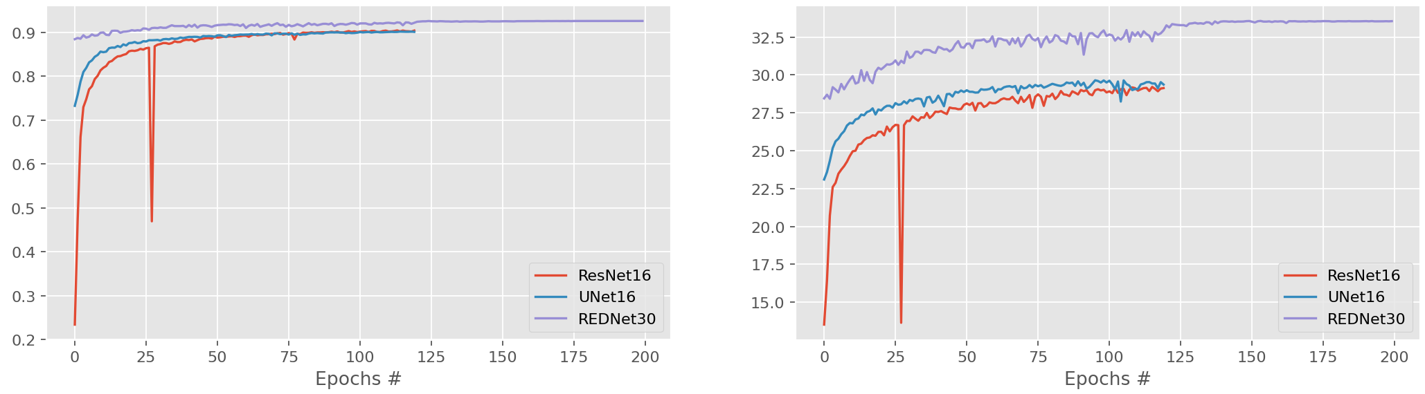
(CAE) Training phase on CIFAR-10
Batch size: 32 (x8 TPU’s replicas)
120 epochs (+ extra 80 epochs for REDNet30)
Adam optimizer
Learning rate: 0.001 (+ exp. decay in REDNet30’s last 80 epochs)
LogCosh loss function (more robust than MSE and differentiable unlike MAE)
SSIM and PSNR metrics to assess image similarity
SSIM
PSNR

Slide 9
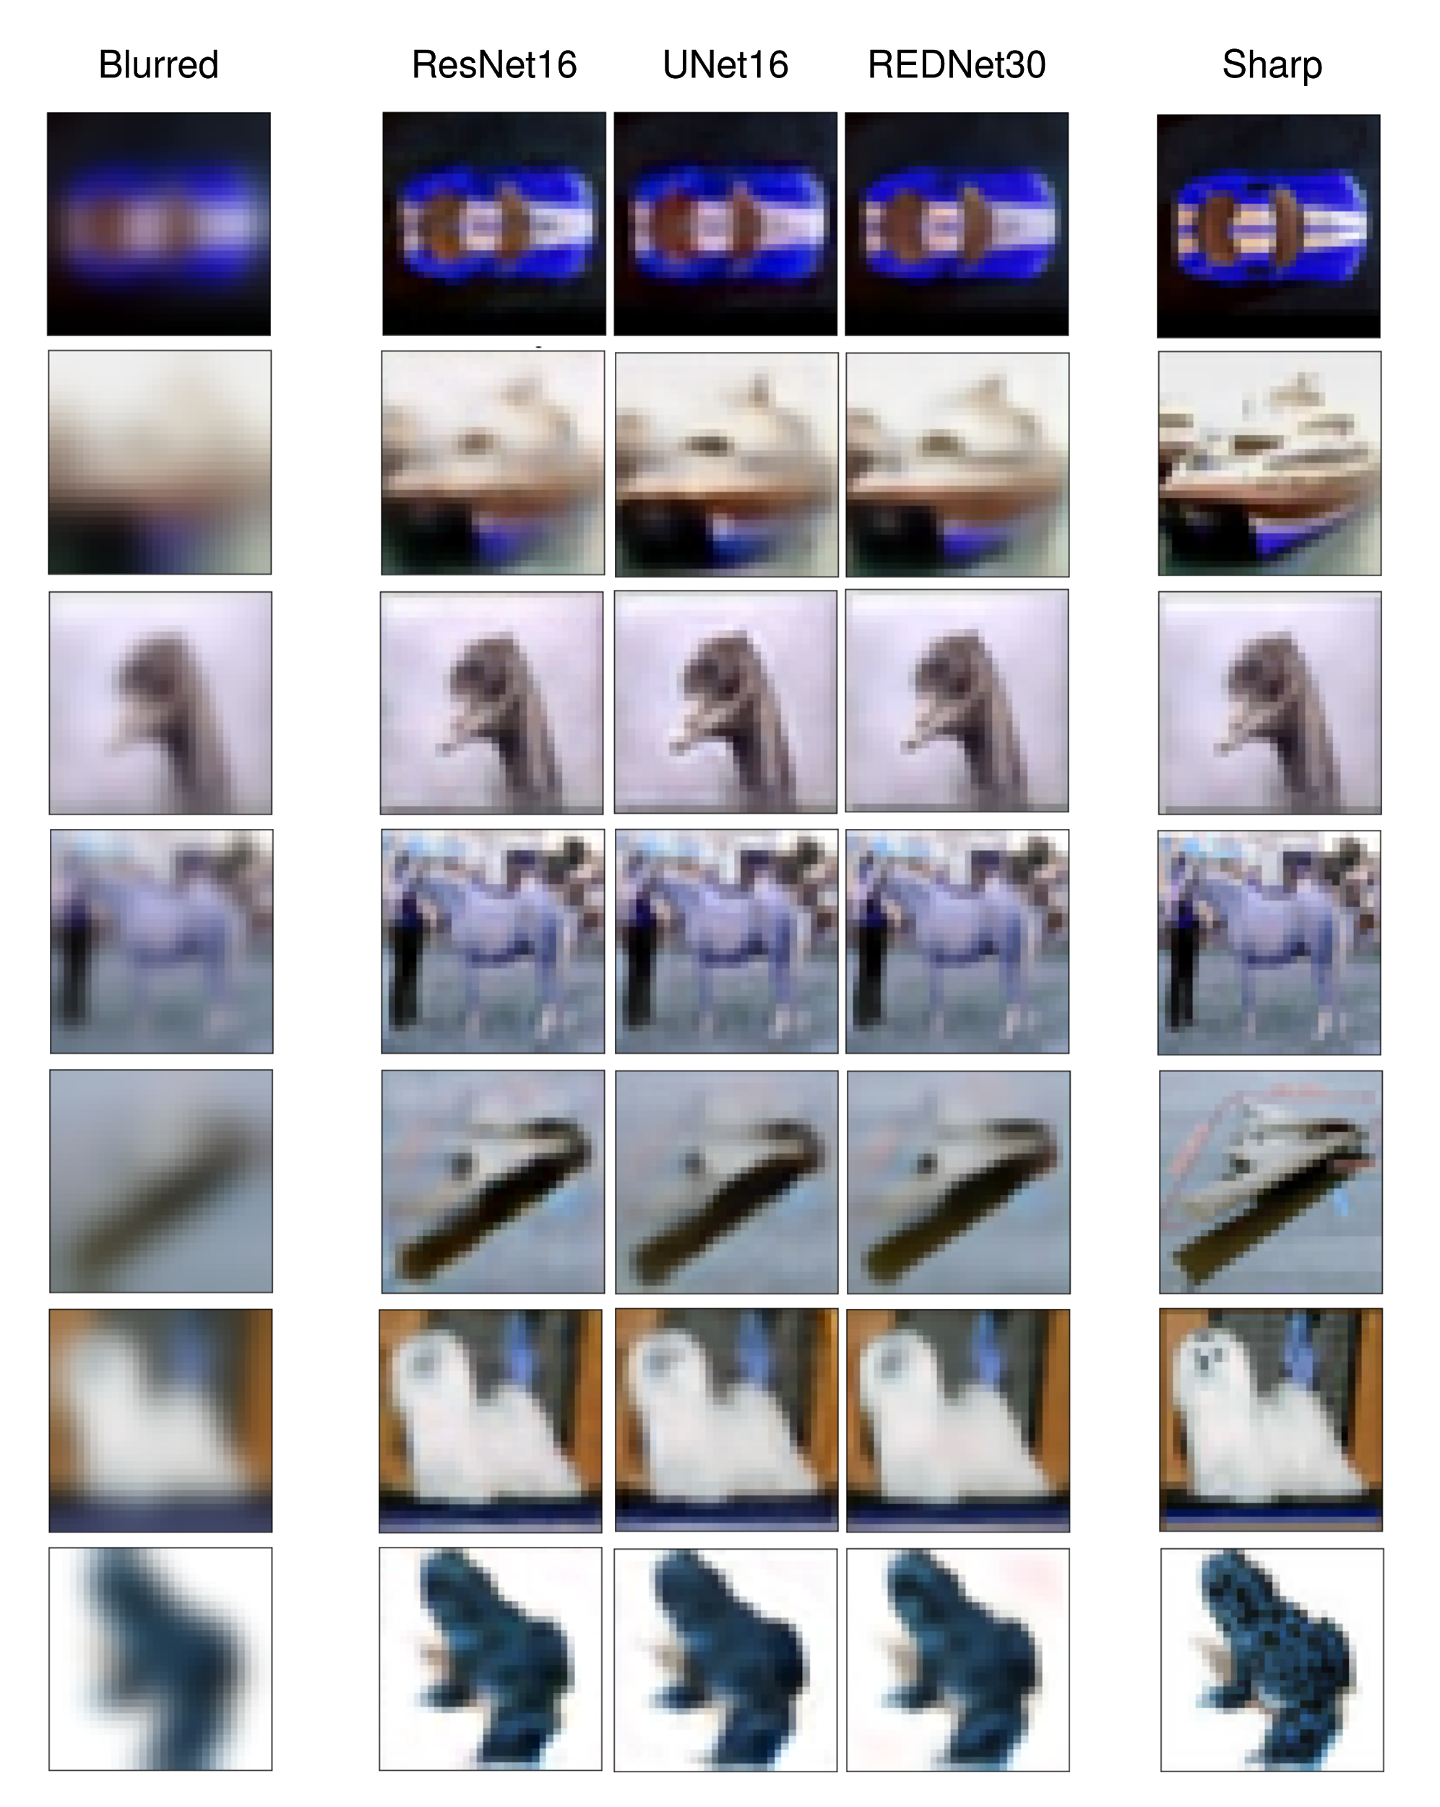
(CAE) Experimental results on CIFAR-10
Blurred
ResNet16
UNet16
REDNet30
Sharp
Model | ResNet16 | UNet16 | REDNet30 | Baseline
Loss [10⁻⁴] | 9.794 | 10.44 | 6.966 | 34.48
SSIM | 0.9034 | 0.9001 | 0.9258 | 0.7135
PSNR | 29.09 | 29.32 | 33.52 | 24.67
MSE [10⁻³] | 1.965 | 2.095 | 1.398 | 6.317
MAE [10⁻²] | 2.888 | 2.898 | 2.165 | 4.517

Slide 10
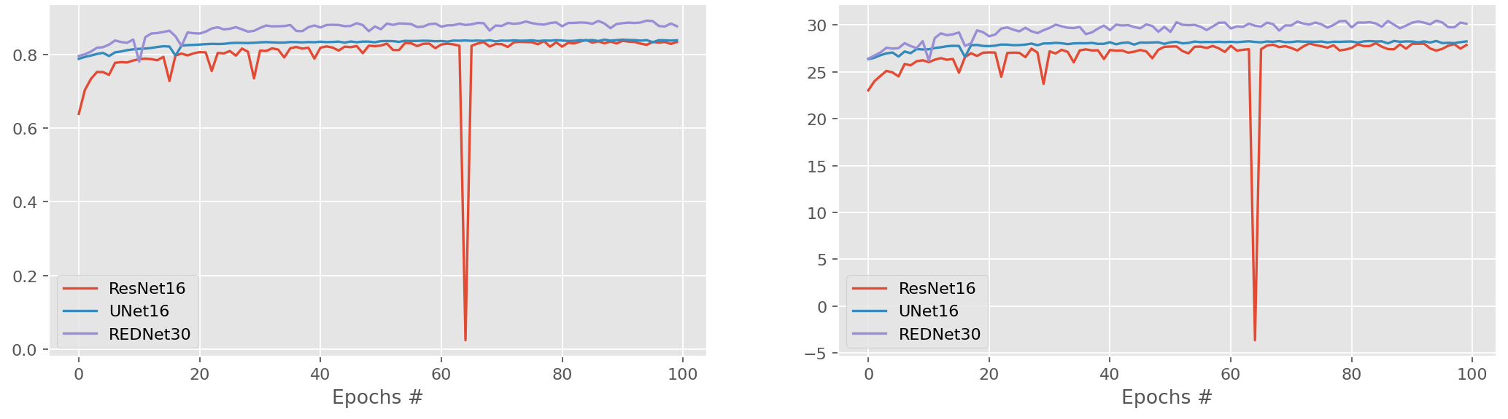
(CAE) Training phase on REDS
100 epochs instead of 120
Other parameters remained unchanged
SSIM
PSNR

Slide 11
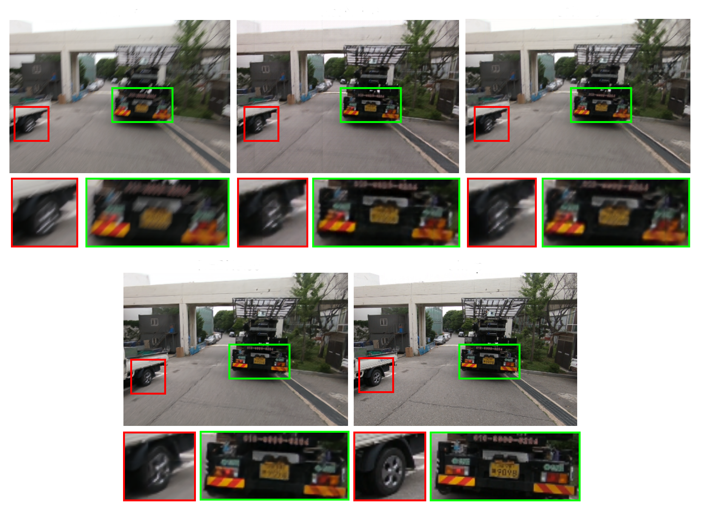
(CAE) Experimental results on REDS
Blurred
ResNet16
UNet16
Model | ResNet16 | UNet16 | REDNet30 | Baseline
Loss [10⁻⁴] | 8.669 | 8.763 | 5.793 | 19.54
SSIM | 0.8554 | 0.8646 | 0.8976 | 0.8237
PSNR | 29.49 | 30.41 | 31.98 | 28.80
MSE [10⁻³] | 1.742 | 1.761 | 1.163 | 2.594
MAE [10⁻²] | 2.536 | 2.312 | 1.884 | 2.118
REDNet30
Sharp

Slide 12
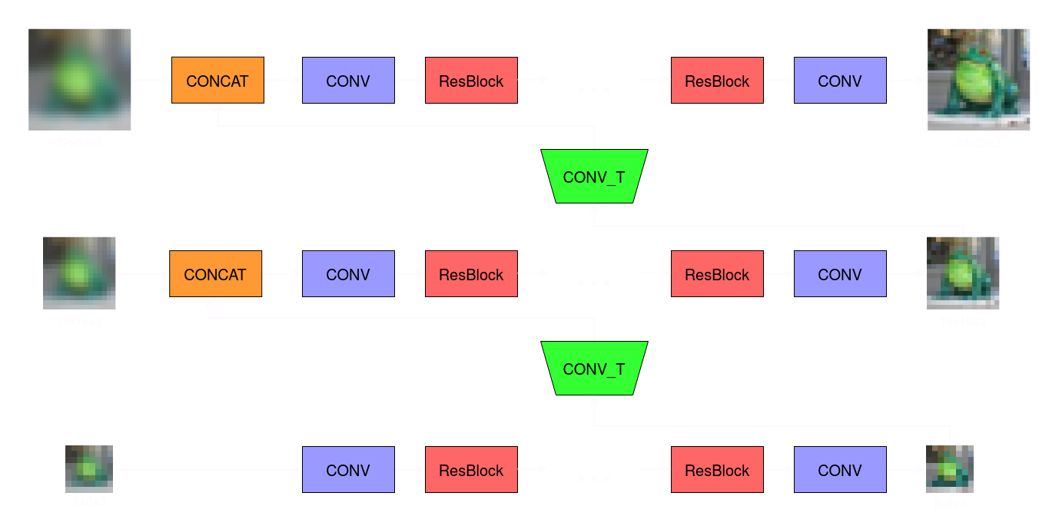
WGANs - MSDeblurWGAN generator
It comprises three branches, each made of 19 ResBlocks:
branch for coarsest resolution
branch for middle resolution (which relies on the coarsest one)
branch for finer resolution (which relies on the middle one)

Slide 13
WGANs - REDNet30WGAN generator
The architecture of the generator is the same as the one of REDNet30, since it performed well as a standard CAE

Slide 14
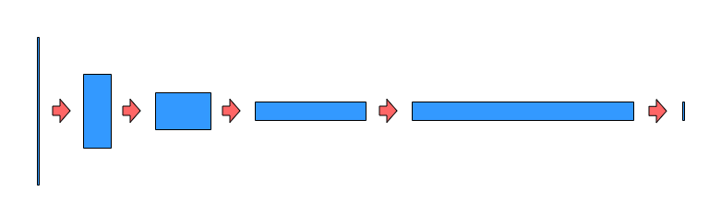
WGANs - PatchGAN critic
The discriminator in WGANS (called critic) computes a 1-Lipschitz continuous function:
apply basic 4x4 convolution with stride 2
use of Layer Normalization
To obtain the image score the last 16 values are averaged to get a single value

Slide 15
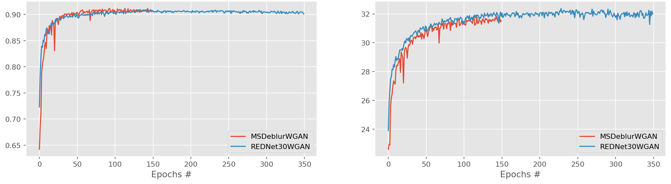
(WGAN) Training phase on CIFAR-10
Batch size: 32 (x8 TPU’s replicas)
150 epochs for MSDeblurWGAN, 350 epochs for REDNet30WGAN
Adam optimizer
Learning rate: 2 • 10⁻⁴
Content loss: LogCosh (multi-scale version for MSDeblurWGAN)
Adversarial loss: negated critic’s score
SSIM and PSNR metrics to assess image similarity
Gradient penalty technique to enforce 1-Lipschitz constraint
At every generator’s train step, the critic is trained 5 times
SSIM
PSNR

Slide 16
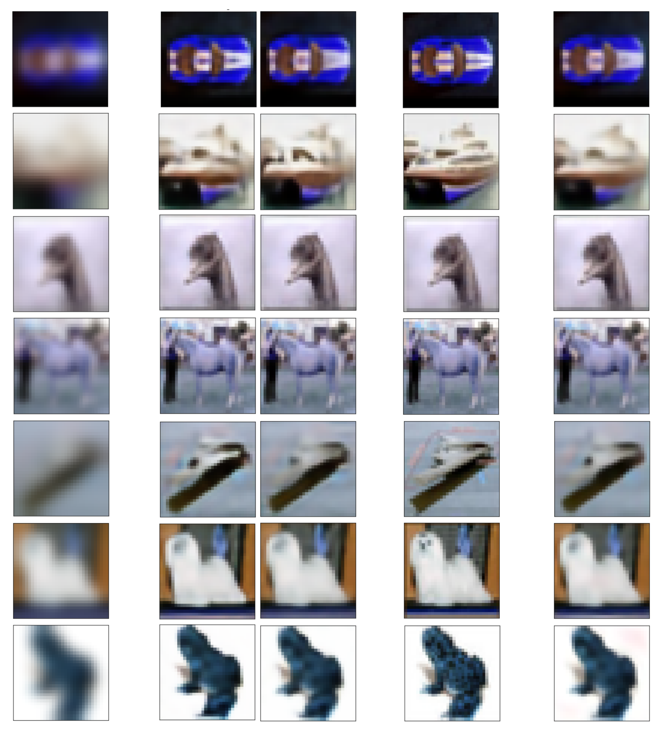
(WGAN) Experimental results on CIFAR-10
Blurred
MSDeblurW.
REDNet30W.
Sharp
REDNet30
Model | MSDeblurWGAN | REDNet30WGAN | REDNet30 | Baseline
Loss | 0.1254 | -0.0057 | --- | ---
SSIM | 0.9054 | 0.9012 | 0.9258 | 0.7135
PSNR | 31.49 | 31.98 | 33.52 | 24.67
MSE [10⁻³] | 1.734 | 1.900 | 1.398 | 6.317
MAE [10⁻²] | 2.471 | 2.482 | 2.165 | 4.517

Slide 17
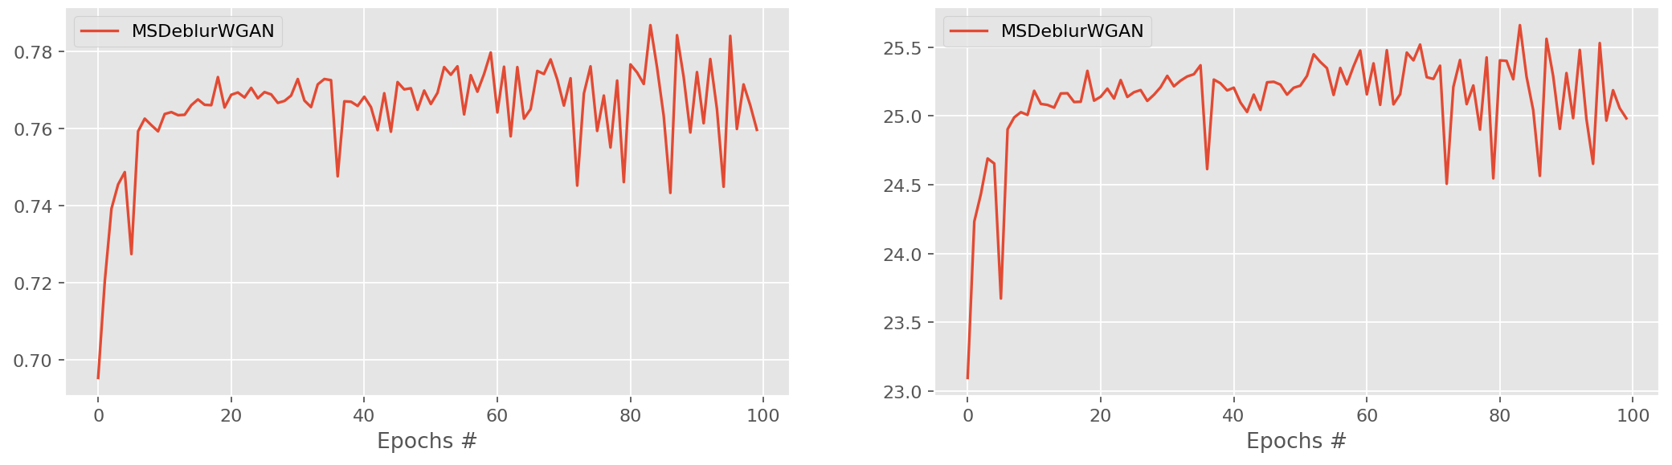
(WGAN) Training phase on REDS
100 epochs (MSDeblurWGAN only)
Number of ResBlocks reduced from 19 to 5
Lower image resolution (256x144 instead of 512x288)
SSIM
PSNR

Slide 18
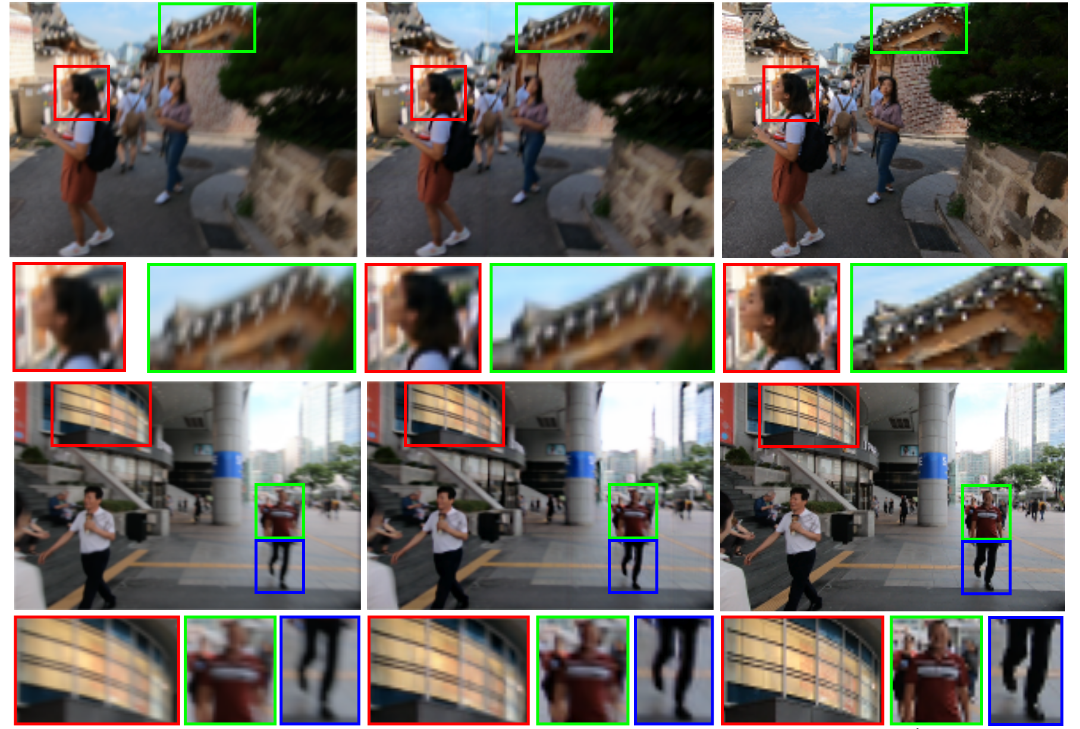
(WGAN) Experimental results on REDS
Blurred
MSDeblurWGAN
Sharp
Model | MSDeblurWGAN | REDNet30 | Baseline
Loss | 0.2195 | --- | ---
SSIM | 0.8031 | 0.8976 | 0.8359
PSNR | 27.11 | 31.98 | 27.68
MSE [10⁻³] | 1.729 | 1.163 | 3.120
MAE [10⁻²] | 2.495 | 1.884 | 2.390

Slide 19
Tools
Google Colab’s TPU:
training performed in parallel across 8 replicas
results are reduced into a single value
Files in tfrecord format on Google Cloud Storage
Brain floating point:
half bits employed (16) w.r.t. standard 32-bit floating point
same dynamic range

Slide 20
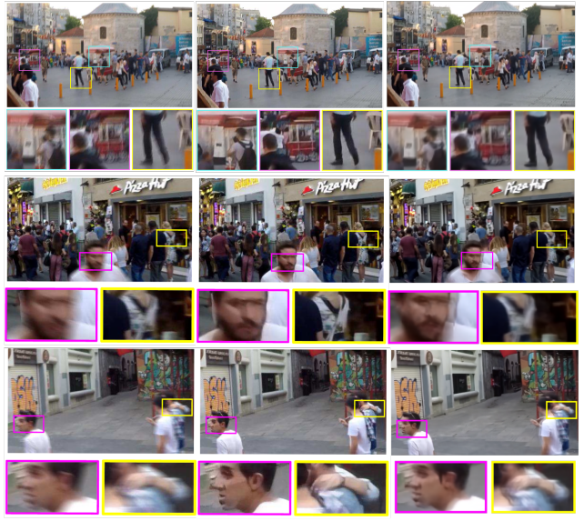
REDNet30 on GOPRO
Blurred
Nah et al.
REDNet30
REDNet30 trained on REDS dataset
Does not reach Nah’s DeepDeblur’s performance
Still able to reconstruct smaller details in GOPRO test images
Some generalization capabilities

